Slide 2
Welcome to Chapter 4!
Designing Flexible Learning Experiences

Slide 3
Session Objectives
Design and implement effective blended learning experiences
Select and utilize appropriate digital learning tools, such as learning management systems (LMS) and open educational resources (OERs)
Notes:
🕧 = 1 minute
Welcome the group to the session on key concepts of designing effective blended learning experiences and utilizing digital tools to create engaging and accessible learning environments for adult learners
Introduce today’s focus = designing flexible learning experiences
Review today’s objectives:
Design and implement effective blended learning experiences that combine face-to-face instruction and online learning elements, aligning them with clear learning objectives and outcomes to create engaging and accessible learning environments for adult learners.
Select and utilize appropriate digital learning tools, such as learning management systems (LMS) and open educational resources (OERs), to organize content, facilitate communication, and monitor learner progress in order to enhance the overall learning experience for adult learners in blended learning environments.
By the end of this session, we will have a solid foundation that can be used to continue designing, implementing, and improving flexible learning experiences

Slide 4
Session Agenda
Reflect on experiences with blended learning
Review blended learning concepts
Discuss the SAMR model
Design effective blended learning experiences
Explore next steps
Notes:
🕧 = 1 minute
Today’s agenda includes opportunities to explore theoretical ideas, to share ideas with our peers/colleagues, and to spend time applying key principles of adult learning into our classrooms and programs.
Warm-up: Engage participants in an activity to share experiences and insights related to blended learning.
Overview of Blended Learning Concepts: Provide a brief overview of blended learning principles for creating engaging and accessible learning environments.
Group Discussion: Exploring SAMR examples
Application Activity: Guide participants in applying blended learning concepts into their own teaching contexts.
Q&A and Wrap-up: Answer questions, facilitate final discussions, and provide reminders of available resources for ongoing support.

Slide 5
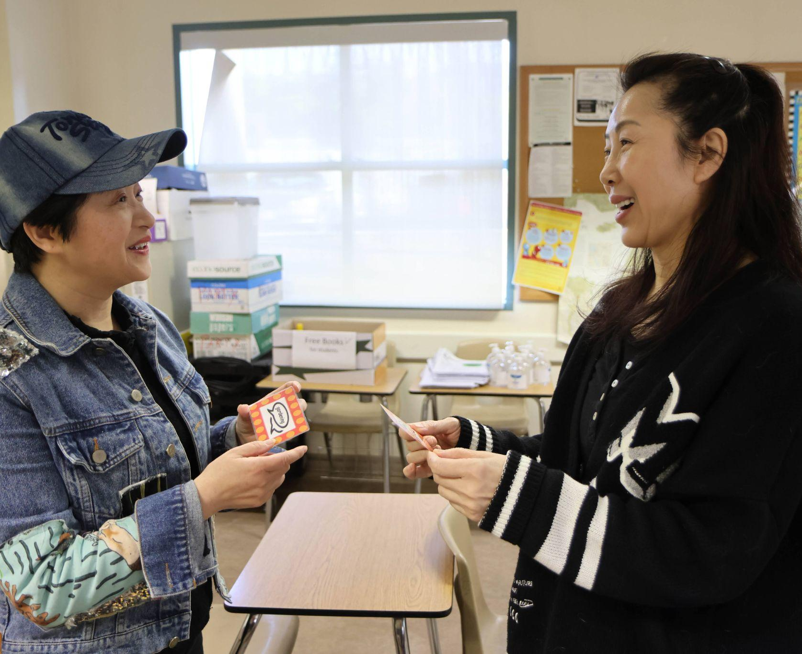
Quick Brainstorm
Think-Pair-Share
What’s a challenge you’ve experienced with designing blended learning experiences? How did you address the challenge?
Reflect on a successful blended learning moment or experience. What strategies or approaches were used?
🗨️ Post your response to this Jamboard
Notes:
🕧 = 10 minutes
🗣️ Facilitation tip. The purpose of this warm-up activity is to foster a collaborative and supportive environment, encouraging open dialogue and knowledge-sharing.There is no “right” or “wrong” answer, which is important to emphasize.
We'll start with a warm-up activity focused on your experience in designing effective blended learning experiences. We want to tap into your experiences as educators and gather insights from your challenges and successes with blended learning. This discussion will help us learn from each other and develop some general ideas that we can use to continue building and improving blended learning environments.
🗣️ Facilitation tip. It may help to offer a brief definition of blended learning: “Blended learning is an educational approach that combines face-to-face instruction with online learning elements, creating a cohesive and integrated learning experience that leverages the benefits of both modalities.”
💻 Digital tools connection. Be sure to set-up the Jamboard before the session and add the link/code to the speaker notes and to the slide for easy reference. Here’s how (🚩Note that you’ll need to create an account to use this feature). It may also be helpful to create two pages: one for “challenges” and another for “successes”.
Navigate to Jamboard on your device or smartphone. You can access it by visiting [provide Jamboard URL].
You can “Make a copy” of this template as well.
Once you're on the Jamboard, you'll see two questions on each slide or page:
What’s an example of a challenge you’ve experienced with designing blended learning experiences? How did you address the challenge?
Reflect on a successful blended learning experience. What innovative strategies or approaches were used?
Take a moment to reflect on your own teaching experiences and consider specific examples of blended learning that have gone well and others that could have been better.
Share your responses by typing them into the respective Jamboard.
As you edit your responses, they will appear on the screen in real-time, allowing everyone to see and engage with the ideas being shared.
🗣️ Facilitation tip. After everyone has had a chance to response, you can spend a few minutes highlighting interesting responses. Be careful not to suggest any response or correct or incorrect. Instead, just highlight anything that is thought-provoking. As you read responses, say things like:
“Oh that’s interesting.”
“Has anyone experienced something similar?”
“That’s insightful.

Slide 6
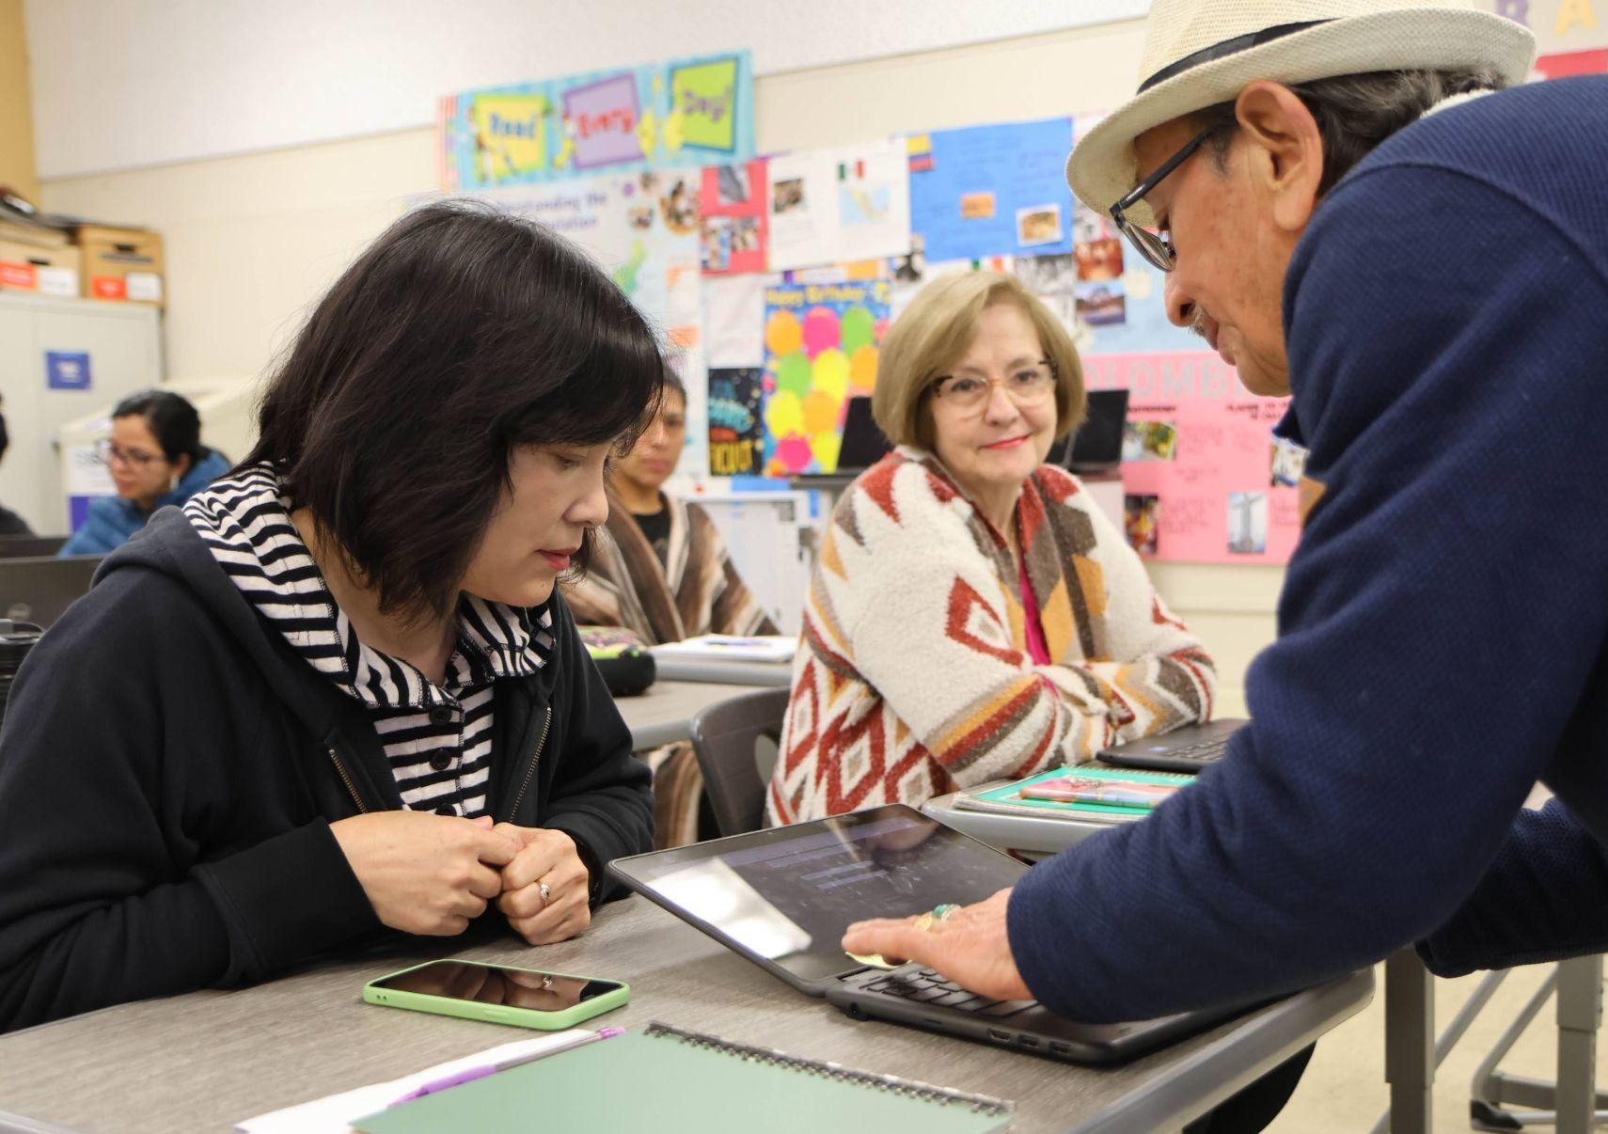
Blended Learning Recap
Key Concepts of Blended Learning
Learning objectives
Learning Management Systems (LMS)
Open Educational Resources (OERs)
Digital content and tools
Equity and accessibility
Notes:
🕧 = 3 minutes
Clear Learning Objectives: Highlight the significance of establishing clear learning objectives and outcomes for a successful blended learning experience.
Learning Management Systems (LMS) and Open Educational Resources (OERs): Discuss the importance of using LMS platforms and OERs to organize content, facilitate communication, and enhance the learning process.
Evaluation of Digital Content and Tools: Stress the need for evaluating the quality and effectiveness of digital content and tools to ensure they align with learning objectives and meet instructional needs.
Equity Considerations: Emphasize the importance of equity in blended learning, including addressing accessibility, inclusivity, and accommodating diverse learning needs.
Benefits of Accessible and Inclusive Learning Environments: Explain how creating accessible and inclusive learning environments can enhance engagement, participation, and overall learning outcomes.

Slide 7
Discussion on Blended Learning
In small groups
Explore one of the following topics from the Digital Learning Guidance (p. 69-77)
Digital tools for communication
Digital tools for collaboration
LMS selection
OER integration
Discuss the questions on the following slide and be ready to share highlights of the conversation with the group!
Notes:
🕧 = 1 minute
🗣️ Facilitation tip. Encourage participants to reference the DLG during their conversation (link). Page 66-77 include useful anecdotes, links to digital tools, and other insights related to each topic.
Introduce the activity:
Divide participants into small groups and assign each group a specific topic related to the chapter content (e.g., Digital tools for communication, digital tools for collaboration
LMS selection, OER integration).
Provide discussion prompts for each group to explore their assigned topic and share insights, challenges, and best practices.
Discussion prompts can be found on the next slide.
Encourage participants to reference the DLG and share any examples or experiences they have encountered.

Slide 8
Discussion Questions
Digital tools for communication
How have digital tools changed the way you communicate with students? Which tools have you found to be most accessible and effective?
Digital tools for collaboration
How have digital tools enabled students to collaborate with peers and instructors? Which tools have you found to be most useful?
LMS selection
What key features do you find to be essential for hosting your distance and blended learning materials?
OER integration
What sources have you found to be useful for finding OERs for your class? How do you evaluate OER quality and relevance?
Notes:
🕧 = 15 minutes
Remind groups that they should take notes as they talk and nominate one person to highlight key ideas or interesting elements of the conversation.
Timing:
Small group discussion can last for 5-7 minutes
Each group reporting on their discussion can last for another 5-7 minutes
🗣️ Facilitation tip. There are several questions listed on this slide, each of which may generate an interesting conversation. As you frame the activity for participants, note that it’s okay if they don’t answer every question or even have time to explore each item. It’s okay if they let the conversation develop organically and then report back on the more interesting elements of the discussion.

Slide 9
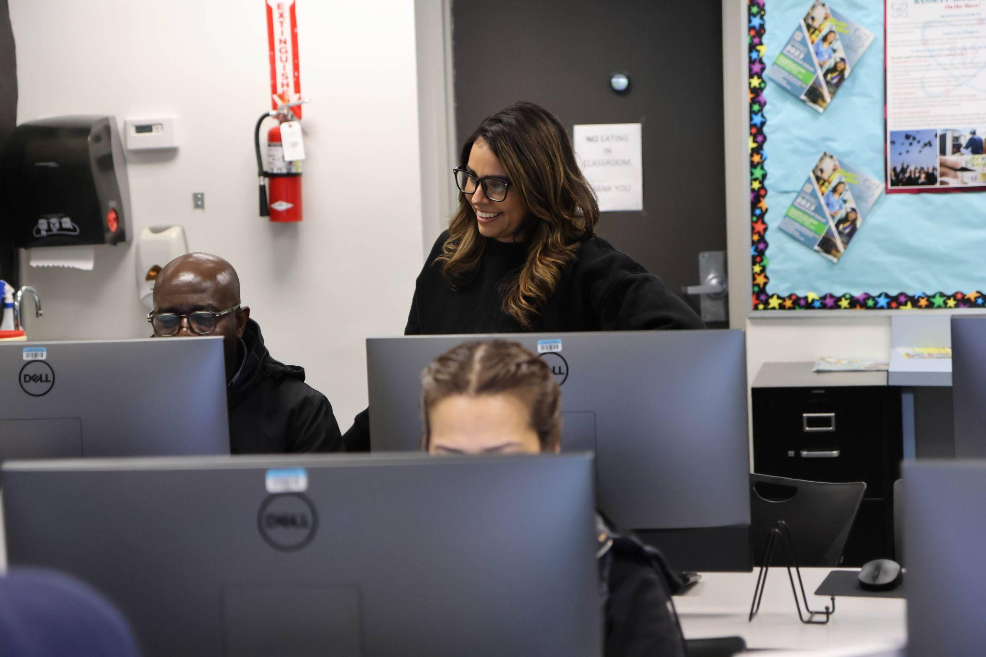
Exploring SAMR
Technology can be used in a number of ways:
S: Substitution
A: Augmentation
M: Modification
R: Redefinition
Notes:
🕧 = 3 minutes
Introduce the SAMR model
The SAMR model is a framework used to evaluate and enhance technology integration in education.
As we consider ways to design effective blended learning experiences, the SAMR model can be a great tool for reviewing how well we are using technology itself
Simply put, the SAMR model is a tool that helps teachers gauge how technology is used in the classroom, allowing them to move beyond basic substitution and toward more transformative and impactful learning experiences. It provides a framework for integrating technology in ways that enhance teaching and promote critical thinking.
SAMR stands for Substitution, Augmentation, Modification, and Redefinition, representing different levels of technology integration.
At the substitution level, technology acts as a direct substitute for traditional tools without significant changes in the task.
Augmentation involves technology use that offers functional improvements compared to traditional methods.
Modification occurs when technology allows for significant task redesign and offers new possibilities.
Finally, redefinition refers to technology enabling the creation of entirely new tasks and transforming the learning experience. The SAMR model encourages educators to progress from substitution to redefinition to leverage the full potential of technology in teaching and learning.

Slide 10
Examples of SAMR
Substitution: Using Microsoft Word instead of pen and paper for writing tasks.
Augmentation: Using Quizlet or similar digital flashcards with interactive features like flipping, shuffling, and self-paced quizzes.
Modification: Collaboratively editing a document in real-time using Google Docs for interactive and collaborative writing tasks.
Redefinition: Creating multimedia presentations with embedded videos, interactive elements, and hyperlinks using software like Prezi or PowerPoint for immersive and interactive learning experiences.
Notes:
🕧 = 3 minutes
Provide an example of SAMR to help participants start to understand what SARM can look like in practice.
This example showcase the progression from simple substitution to more transformative uses of technology.
Substitution: While the task of writing remains the same, the tool used for writing is replaced, offering digital convenience.
Augmentation: These features enhance the traditional flashcard experience, making it more engaging and interactive.
Modification: This collaborative feature allows for simultaneous editing, commenting, and, transforming the traditional individual writing task into a collaborative and interactive experience.
Redefinition: By embedding videos, interactive elements, and hyperlinks, the presentation becomes a dynamic and immersive learning experience that redefines traditional slide-based presentations. In redefining the task, learners are providing with more choice in what they explore, which aligns with andragogy and heutagogy.
📄DLG connection: Participants can reference adult learning principles in Chapter 3 of the DLG.
These examples show how technology integration can progress beyond substitution and augmentation to reach the highest level of transformation, called redefinition. Redefinition occurs when technology enables new and innovative learning experiences that go beyond what was previously possible.
By using the SAMR model as a guide, educators can aim to move beyond basic substitution and augmentation and explore the transformative potential of technology in the classroom."
Ask: What do you notice and wonder about SAMR?
🗣️ Facilitation tip. Your role here is to facilitate conversation by encouraging educators to respond about what they are thinking about in reaction to SAMR concepts. There is no right or wrong answer, so just focus on encouraging dialogue and helping educators connect their ideas to each other’s thoughts and to the model itself.

Slide 11
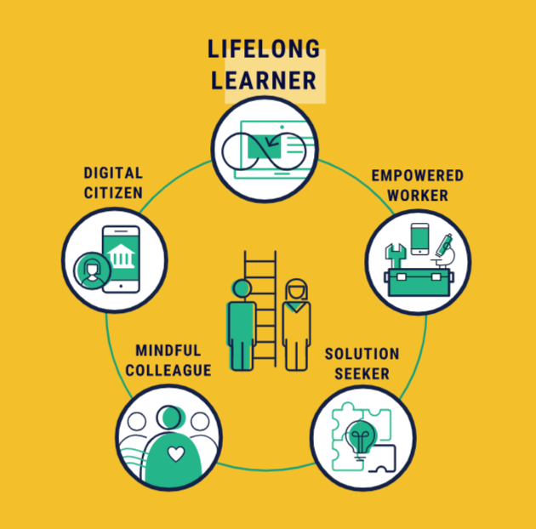
SAMR in Practice
Exploring a micro-learning experience
ISTE’s SkillRise Initiative has developed a micro-learning experience that showcases the SAMR model
Visit mle.skillrise.org/techtransformations to “play” the story (it’s mobile-friendly)
Notes:
🕧 = 5 minutes
If time allows, share this short micro-learning experience from ISTE’s SkillRise
It can also be shared and assigned for review after the session
The MLE is mobile-friendly (i.e. can be “played” on a phone)
Direct link = mle.skillrise.org/techtransformations
If participants complete the activity during the session, consider including a short reflection discussions
“What did you notice or wonder about the content of the story?”
“Are there any elements of the MLE that you are curious to explore brining into your classroom?

Slide 12
Applying SAMR: Social Studies
Subject area: Social Studies
Context: Students are studying a historical event, such as the American Revolution.
Current lesson task: Students create a poster using graphics software to display key facts and figures.
What could be next for SAMR _____________?
Notes:
🕧 = 15 minutes (for the full activity on slides 11-15)
📃 Optional - Make a copy of this template and give to groups to collaboratively edit throughout the activity. Note that directions are included in the speaker notes
Directions for the activity
On the next few slides, examples are presented of lesson plans that include some level of SAMR application.
Divide educators into small groups and assign each group a case study or scenario.
In their groups, educators analyze the task and technology integration, considering the SAMR level already achieved and how they can evolve the technology use and learning activity into the next SAMR level.
Encourage educators to think creatively, leveraging the possibilities of technology to enhance the learning experience.
Bring the groups back together and invite each group to share their ideas for evolving the task to the next SAMR level.
Facilitate a discussion among all participants to explore the strengths, potential impact, and considerations of each proposed task evolution.
Encourage reflection on how these task evolutions could enhance student engagement, critical thinking, collaboration, or real-world connections.
🗣️ Facilitation tip. For each subject area, here are some ideas that you can use to gently nudge groups in a possible direction:
Social Studies: Online collaboration tools like Canva or Padlet, where students work together to create an interactive timeline with multimedia content and links to primary sources.
Language Arts: Digital storytelling tools like Flipgrid or Book Creator to create multimedia book reports with audio, video, and images.
Mathematics: Augmented reality (AR) apps that allow students to scan their surroundings and identify real-life objects as examples of different shapes.
English Language Learning: Students collaborate on creating a podcast or audio recording where they discuss various topics using different verb tenses. They can use audio recording apps or platforms like Anchor or SoundCloud to record and share their podcasts with their peers or a wider audience.

Slide 13
Applying SAMR: Language Arts
Subject area: Language Arts
Context: Students are reading a novel and analyzing the characters and themes.
Current lesson task: Students write a traditional book report using a word processing software.
What could be next for SAMR _____________?
Notes:
Directions for the activity
On the next few slides, examples are presented of lesson plans that include some level of SAMR application.
Divide educators into small groups and assign each group a case study or scenario.
In their groups, educators analyze the task and technology integration, considering the SAMR level already achieved and how they can evolve the technology use and learning activity into the next SAMR level.
Encourage educators to think creatively, leveraging the possibilities of technology to enhance the learning experience.
Bring the groups back together and invite each group to share their ideas for evolving the task to the next SAMR level.
Facilitate a discussion among all participants to explore the strengths, potential impact, and considerations of each proposed task evolution.
Encourage reflection on how these task evolutions could enhance student engagement, critical thinking, collaboration, or real-world connections.
🗣️ Facilitation tip. For each slide, here are some ideas that you can use to gently nudge groups in a possible direction:
Social Studies: Online collaboration tools like Canva or Padlet, where students work together to create an interactive timeline with multimedia content and links to primary sources.
Language Arts: Digital storytelling tools like Flipgrid or Book Creator to create multimedia book reports with audio, video, and images.
Mathematics: Augmented reality (AR) apps that allow students to scan their surroundings and identify real-life objects as examples of different shapes.
English Language Learning: Students collaborate on creating a podcast or audio recording where they discuss various topics using different verb tenses. They can use audio recording apps or platforms like Anchor or SoundCloud to record and share their podcasts with their peers or a wider audience.

Slide 14
Applying SAMR: Math
Subject area: Math
Context: Students are learning about geometry and identifying different shapes.
Current lesson task: Students use a geometry app on tablets to drag and drop shapes into categories.
What could be next for SAMR _____________?
Notes:
Directions for the activity
On the next few slides, examples are presented of lesson plans that include some level of SAMR application.
Divide educators into small groups and assign each group a case study or scenario.
In their groups, educators analyze the task and technology integration, considering the SAMR level already achieved and how they can evolve the technology use and learning activity into the next SAMR level.
Encourage educators to think creatively, leveraging the possibilities of technology to enhance the learning experience.
Bring the groups back together and invite each group to share their ideas for evolving the task to the next SAMR level.
Facilitate a discussion among all participants to explore the strengths, potential impact, and considerations of each proposed task evolution.
Encourage reflection on how these task evolutions could enhance student engagement, critical thinking, collaboration, or real-world connections.
🗣️ Facilitation tip. For each slide, here are some ideas that you can use to gently nudge groups in a possible direction:
Social Studies: Online collaboration tools like Canva or Padlet, where students work together to create an interactive timeline with multimedia content and links to primary sources.
Language Arts: Digital storytelling tools like Flipgrid or Book Creator to create multimedia book reports with audio, video, and images.
Mathematics: Augmented reality (AR) apps that allow students to scan their surroundings and identify real-life objects as examples of different shapes.
English Language Learning: Students collaborate on creating a podcast or audio recording where they discuss various topics using different verb tenses. They can use audio recording apps or platforms like Anchor or SoundCloud to record and share their podcasts with their peers or a wider audience.

Slide 15
Applying SAMR: ELL / ESL
Subject area: ELL / ESL
Context: ESL students are practicing
conversation skills.
Current lesson task: Students create digital flashcards using a flashcard app, such as Quizlet, to review verb conjugations in different tenses. They can include audio pronunciations and example sentences to reinforce their understanding.
What could be next for SAMR _____________?
Notes:
Directions for the activity
On the next few slides, examples are presented of lesson plans that include some level of SAMR application.
Divide educators into small groups and assign each group one of the slides
In groups, educators analyze the task and technology integration, considering the SAMR level already achieved and how they can evolve the technology use and learning activity into the next SAMR level.
Encourage educators to think creatively, leveraging the possibilities of technology to enhance the learning experience.
Each group should edit the slide to incorporate their idea/vision for what’s next in SAMR
Bring the groups back together and invite each group to share their ideas for evolving the task to the next SAMR level.
Facilitate a discussion among all participants to explore the strengths, potential impact, and considerations of each proposed task evolution.
Encourage reflection on how these task evolutions could enhance student engagement, critical thinking, collaboration, or real-world connections.
🗣️ Facilitation tip. For each slide, here are some ideas that you can use to gently nudge groups in a possible direction:
Social Studies: Online collaboration tools like Canva or Padlet, where students work together to create an interactive timeline with multimedia content and links to primary sources.
Language Arts: Digital storytelling tools like Flipgrid or Book Creator to create multimedia book reports with audio, video, and images.
Mathematics: Augmented reality (AR) apps that allow students to scan their surroundings and identify real-life objects as examples of different shapes.
English Language Learning: Students collaborate on creating a podcast or audio recording where they discuss various topics using different verb tenses. They can use audio recording apps or platforms like Anchor or SoundCloud to record and share their podcasts with their peers or a wider audience.

Slide 16
Sharing our SAMR Models
How did the SAMR exercise challenge your thinking about technology integration in teaching and learning?
What insights or ideas did you gain from examining the different levels of SAMR in the provided examples?
What are some potential benefits of moving from one SAMR level to the next in terms of enhancing student engagement and learning outcomes?
How can you leverage the SAMR model to promote creativity, collaboration, and critical thinking among your students?
Notes:
🕧 = 10 minutes
Invite participants to share their solutions or ideas with the larger group.
Facilitate a discussion around the various approaches, strengths, and potential areas for improvement in the proposed solutions.
Encourage participants to reflect on how they can apply these concepts in their own teaching or support roles.
Noted on the slide are a few guiding questions for the reflection exercise. Participants can also share their proposed SAMR ideas as you click through slides 11-15 to visualize each task and subject area.

Slide 17
What’s Next?
Chapter 4 of the Digital Learning Guidance provides more details and discussion of key principles
The self-paced course on the OTAN website includes a multiple choice quiz and extension activities
Continue finding opportunities to simplify program materials to improve readability and accessibility
Notes:
🕧 = 5 minutes
Spend a few minutes reviewing key concepts from the session, including suggestions for continuing to learn about both frameworks:
Today, we explored Ch 4 of the Digital Learning Guidance, which looks at how to design flexible learning experiences, including the importance of establishing clear learning objectives, choosing an appropriate LMS, leveraging the power of Open Educational Resources (OERs), and how to ensure accessibility of our blended learning environments.
As a quick overview of key concepts:
Blended learning combines face-to-face instruction and online learning elements to create effective and engaging learning experiences in adult education.
Clear learning objectives, the use of learning management systems (LMS), and open educational resources (OERs) are crucial for designing and implementing blended learning experiences.
Evaluation of digital content and tools helps ensure their effectiveness and alignment with instructional goals.
Equity considerations emphasize the importance of creating accessible and inclusive learning environments for all learners.
The SAMR model provides a framework for evaluating technology integration and moving from substitution to redefinition in learning tasks.

